Slide 1
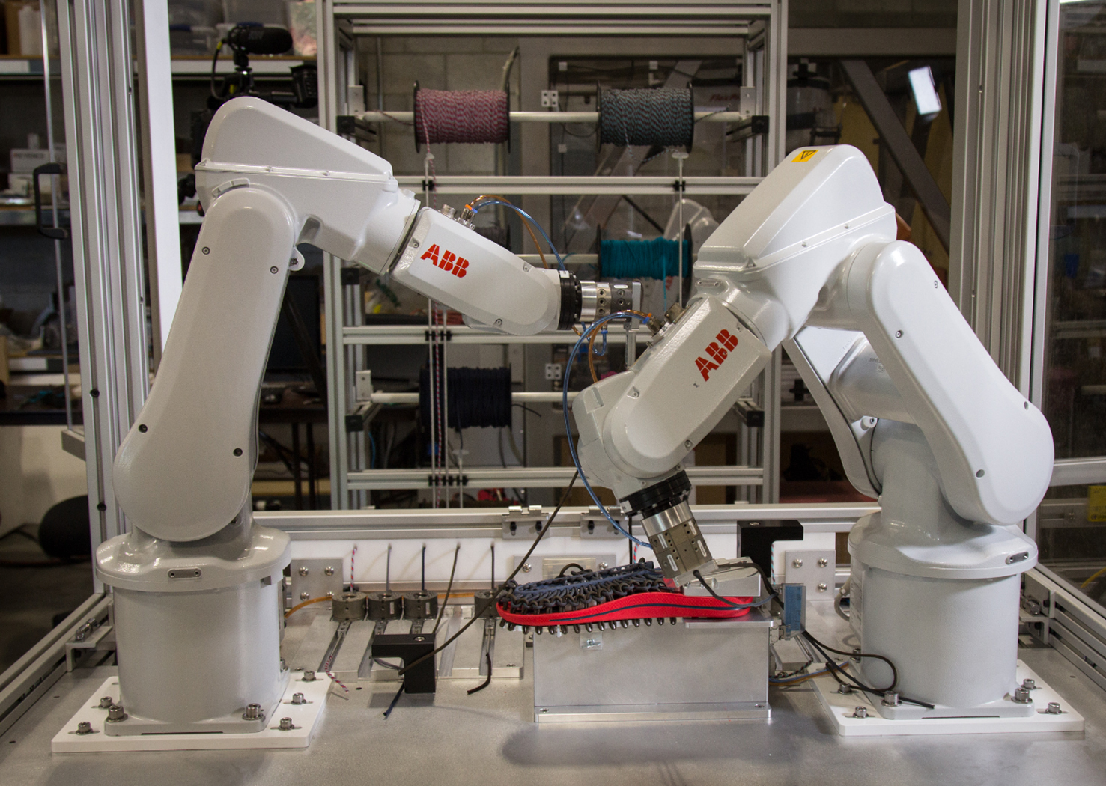
The Economics of Manufacturing Innovation
From Design to Production Line

Slide 2
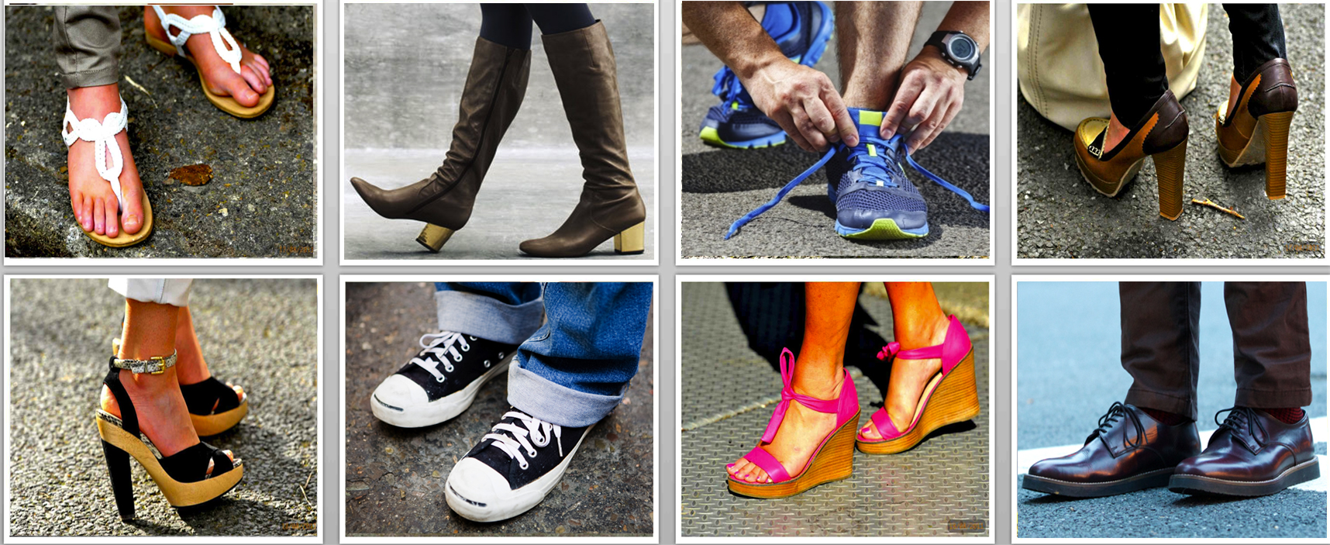
The U.S. Footwear Industry’s Business and Trade Association

Slide 3
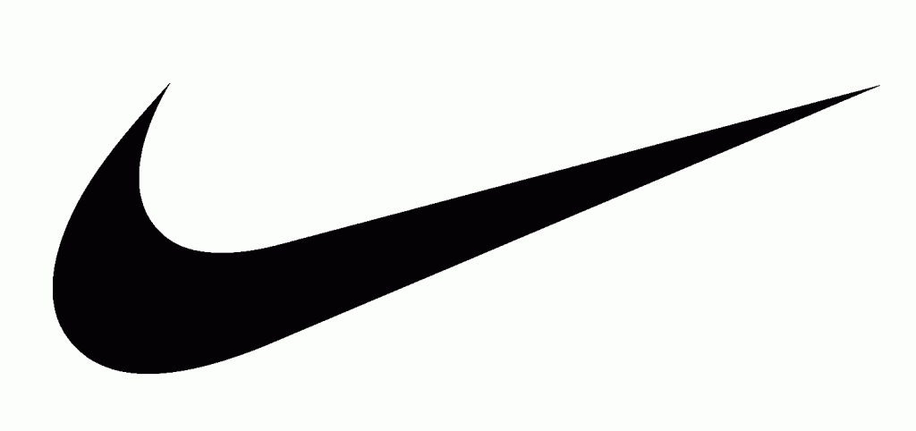
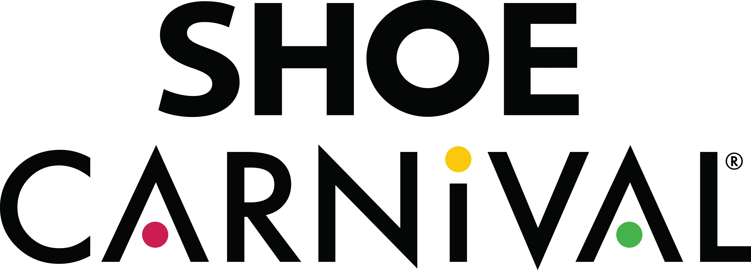

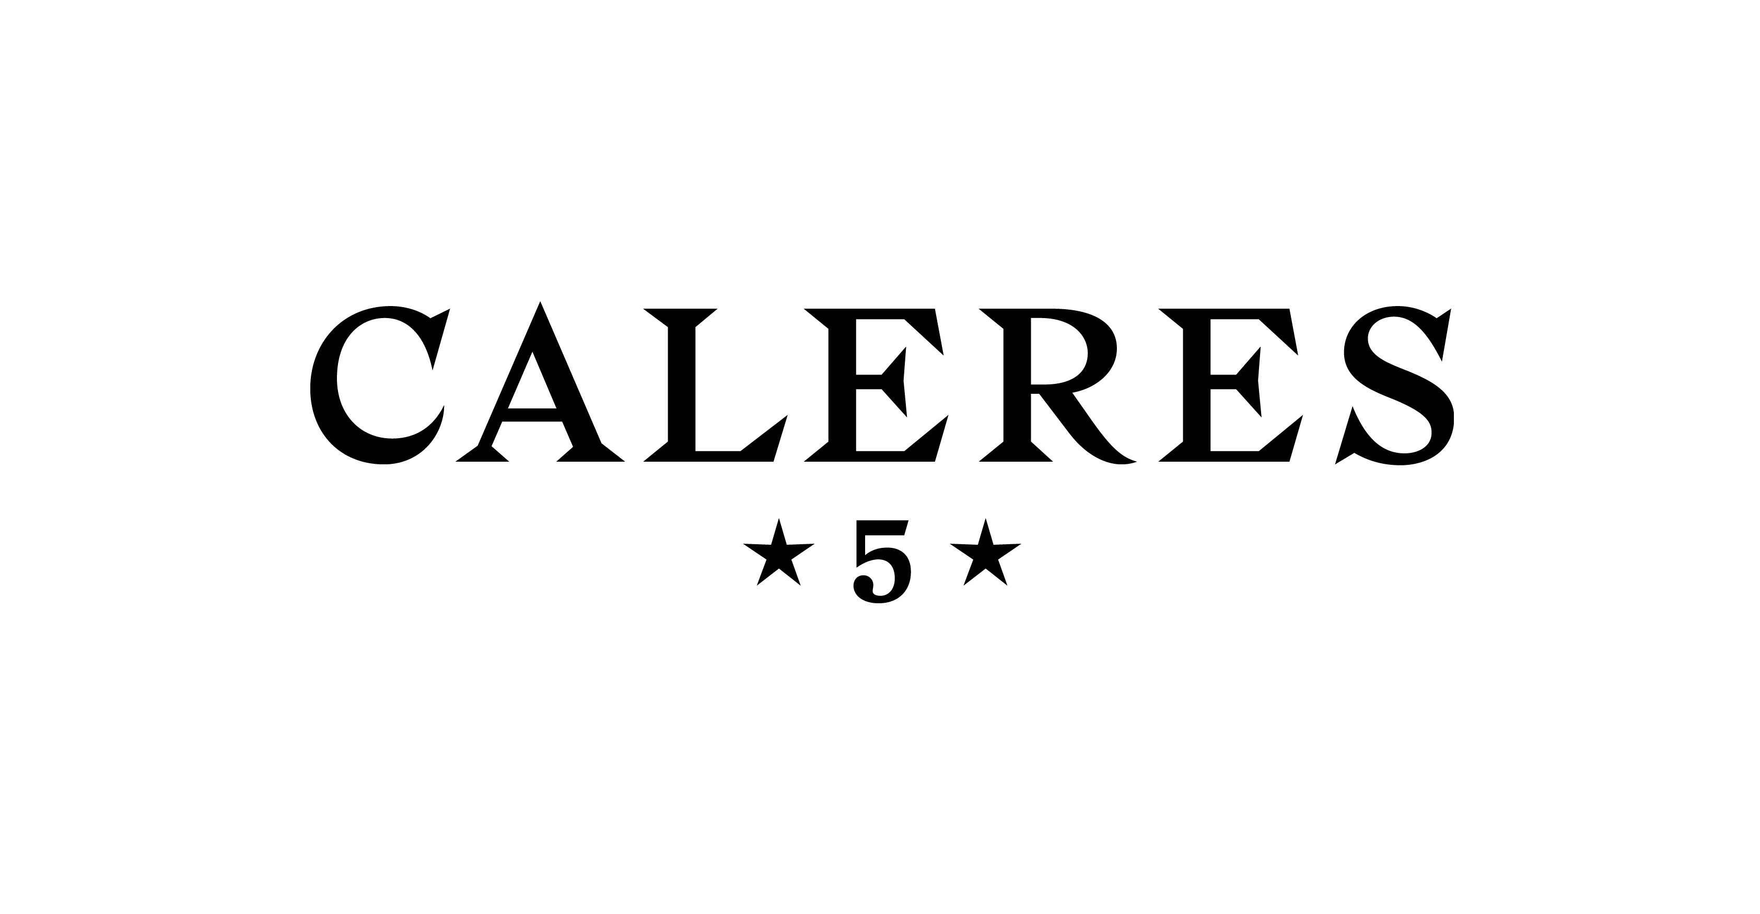
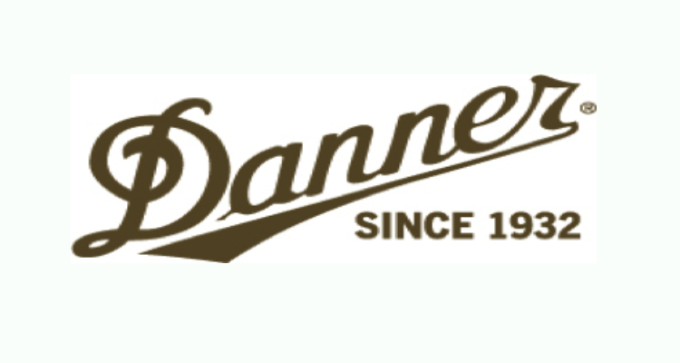



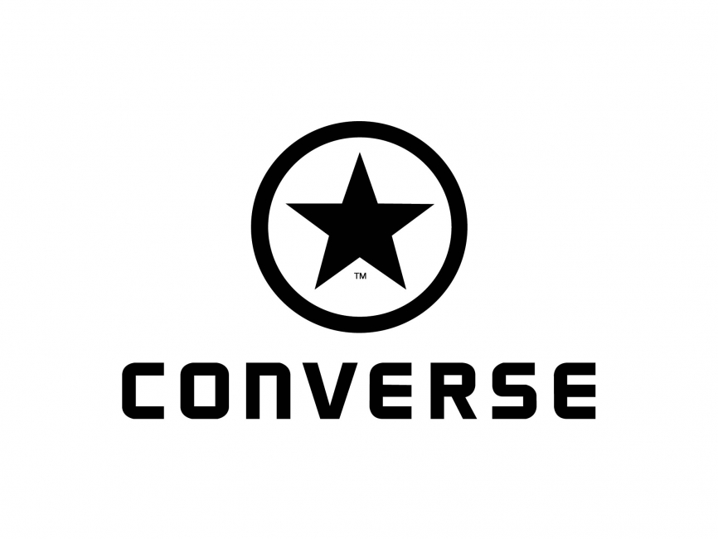
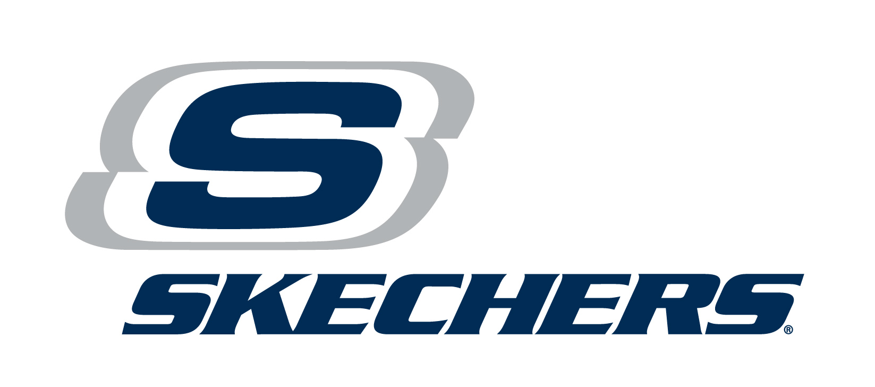
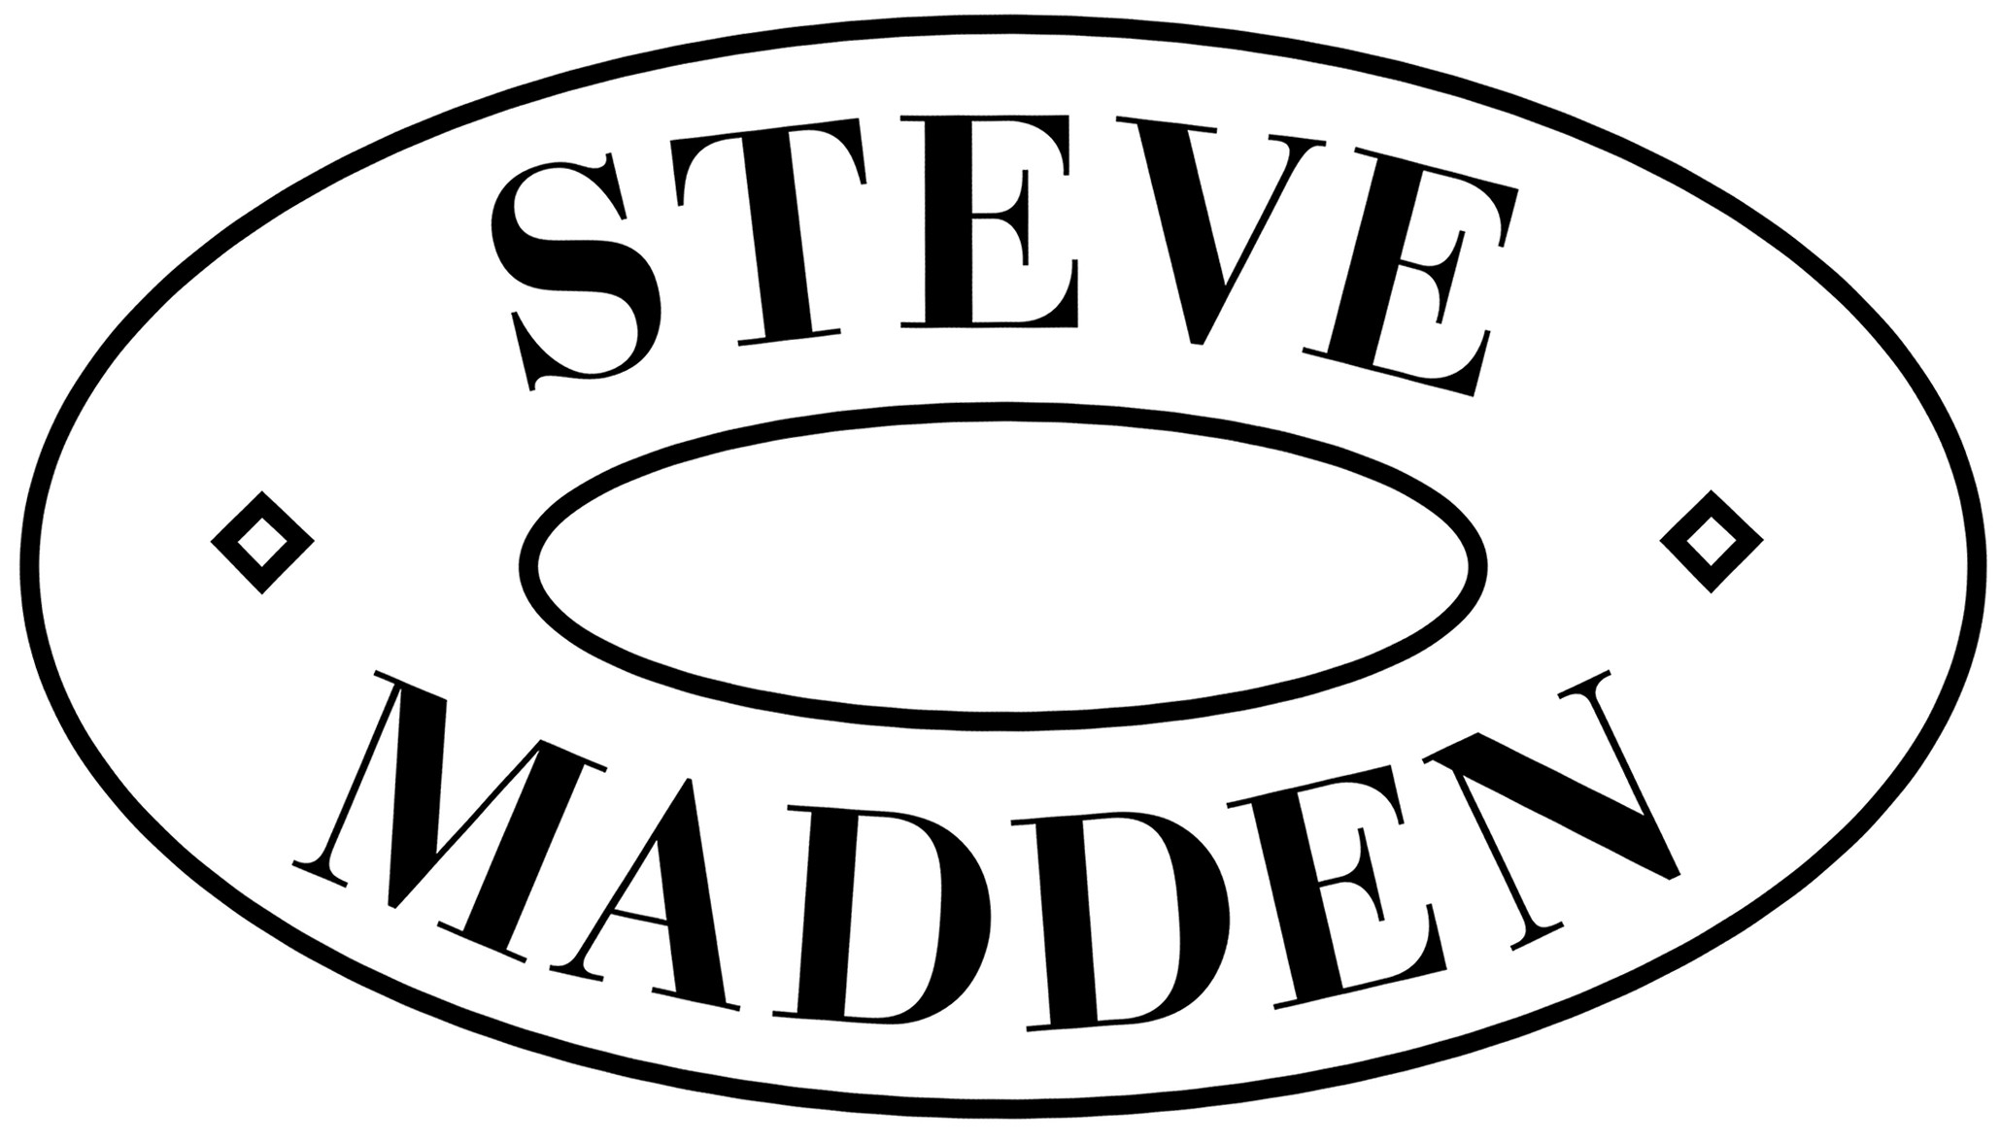




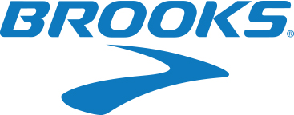
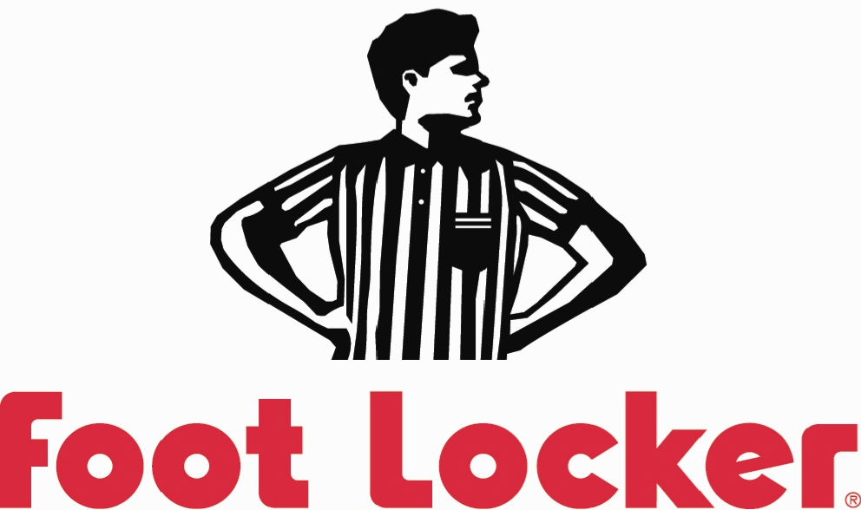




Slide 4


67.5%
The Footwear Industry’s Voice in Washington
Fighting Tariffs on Footwear
48%
11% Average

Slide 5
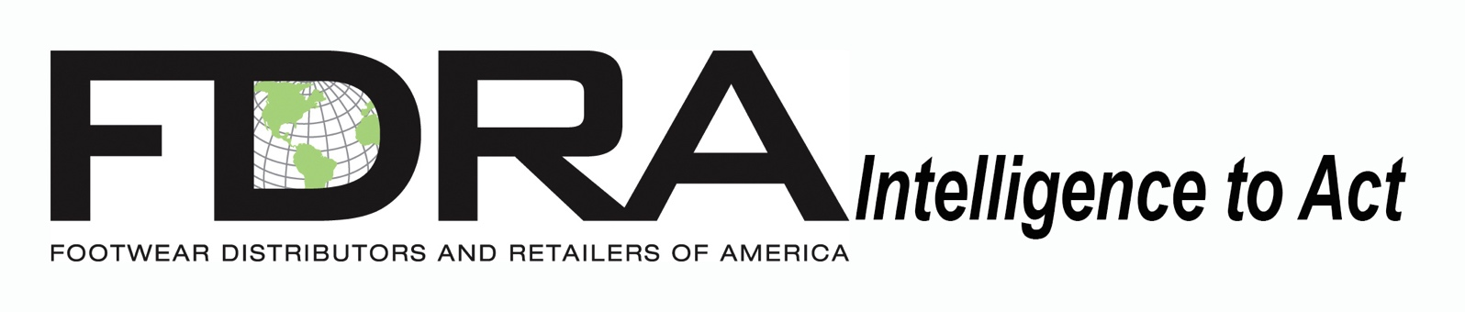
Design: Customs Classifications
Retail Data & Analysis
Supply Chain & Import
Social Compliance
Materials and Product Safety
Production: Development and Global Sourcing

Slide 6
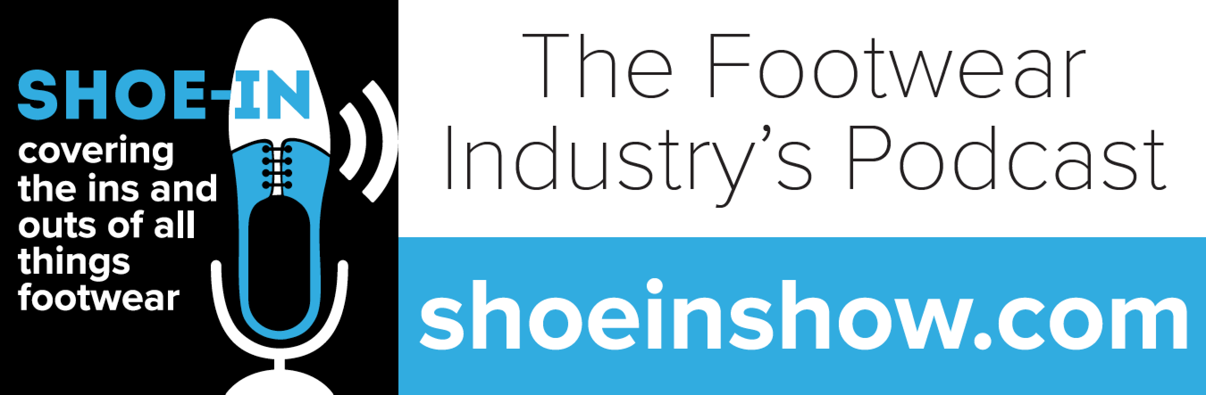
New 30 min. episodes every Monday
Industry Execs and Professionals discussing trends
and hot topics from design to production to retail

Slide 7
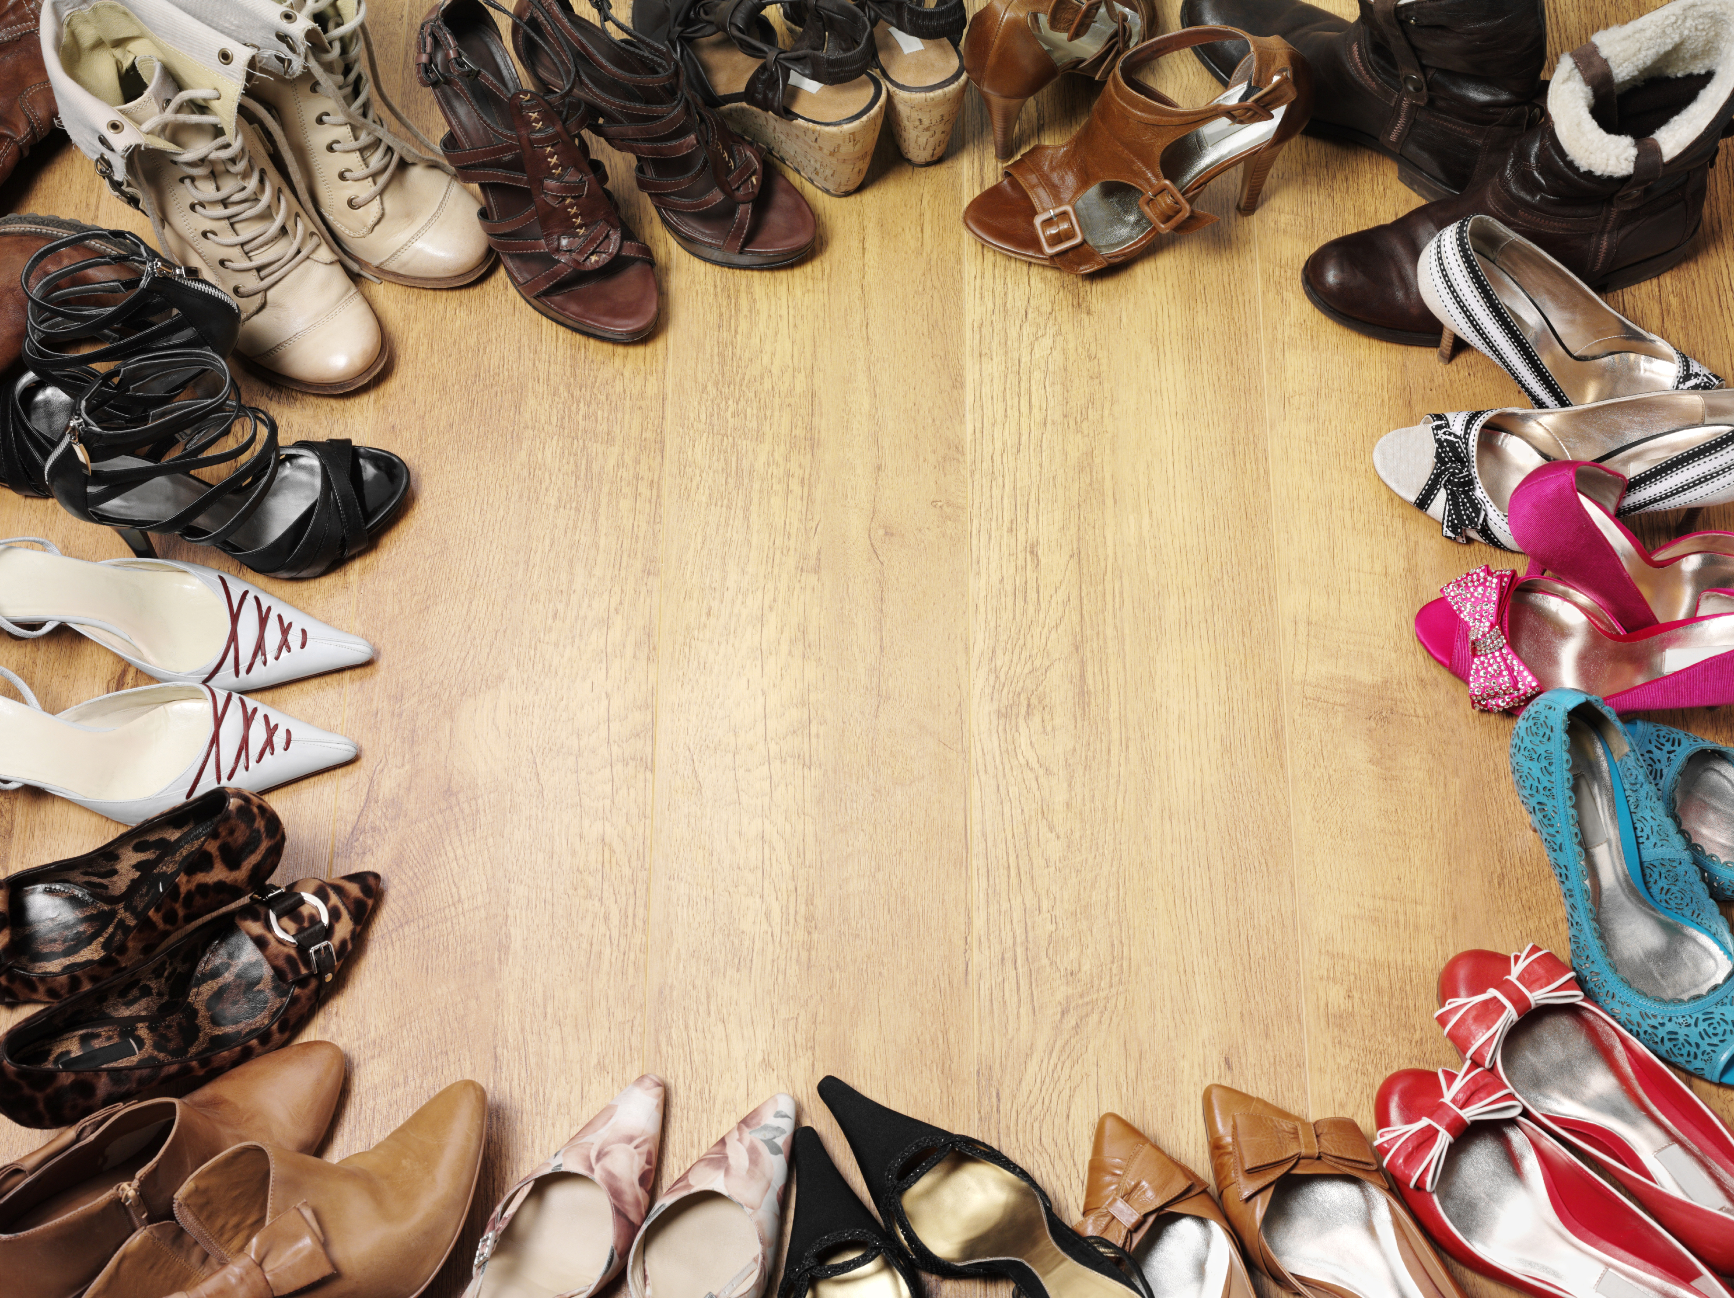
FootWhere?
Footwear Sourcing
By the Numbers

Slide 8

2016 U.S. Footwear Import Volume: 2.35 Billion Pairs
Source: USITC

Slide 9
U.S. Footwear Import Volumes by Largest Suppliers: 2015 vs. 2016
73%
15%
Source: USITC

Slide 10
Distribution of 2016 EU Footwear Import Volume
Source: Eurostat

Slide 11
EU Footwear Import Volumes by Largest Suppliers: 2015 vs. 2016
Source: Eurostat

Slide 12
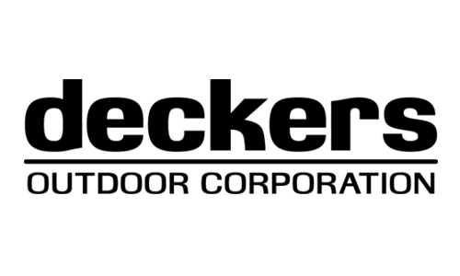
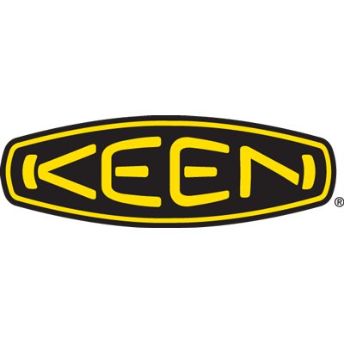

Notes:
Companies I spoke with about trends. A cross section of the industry

Slide 13
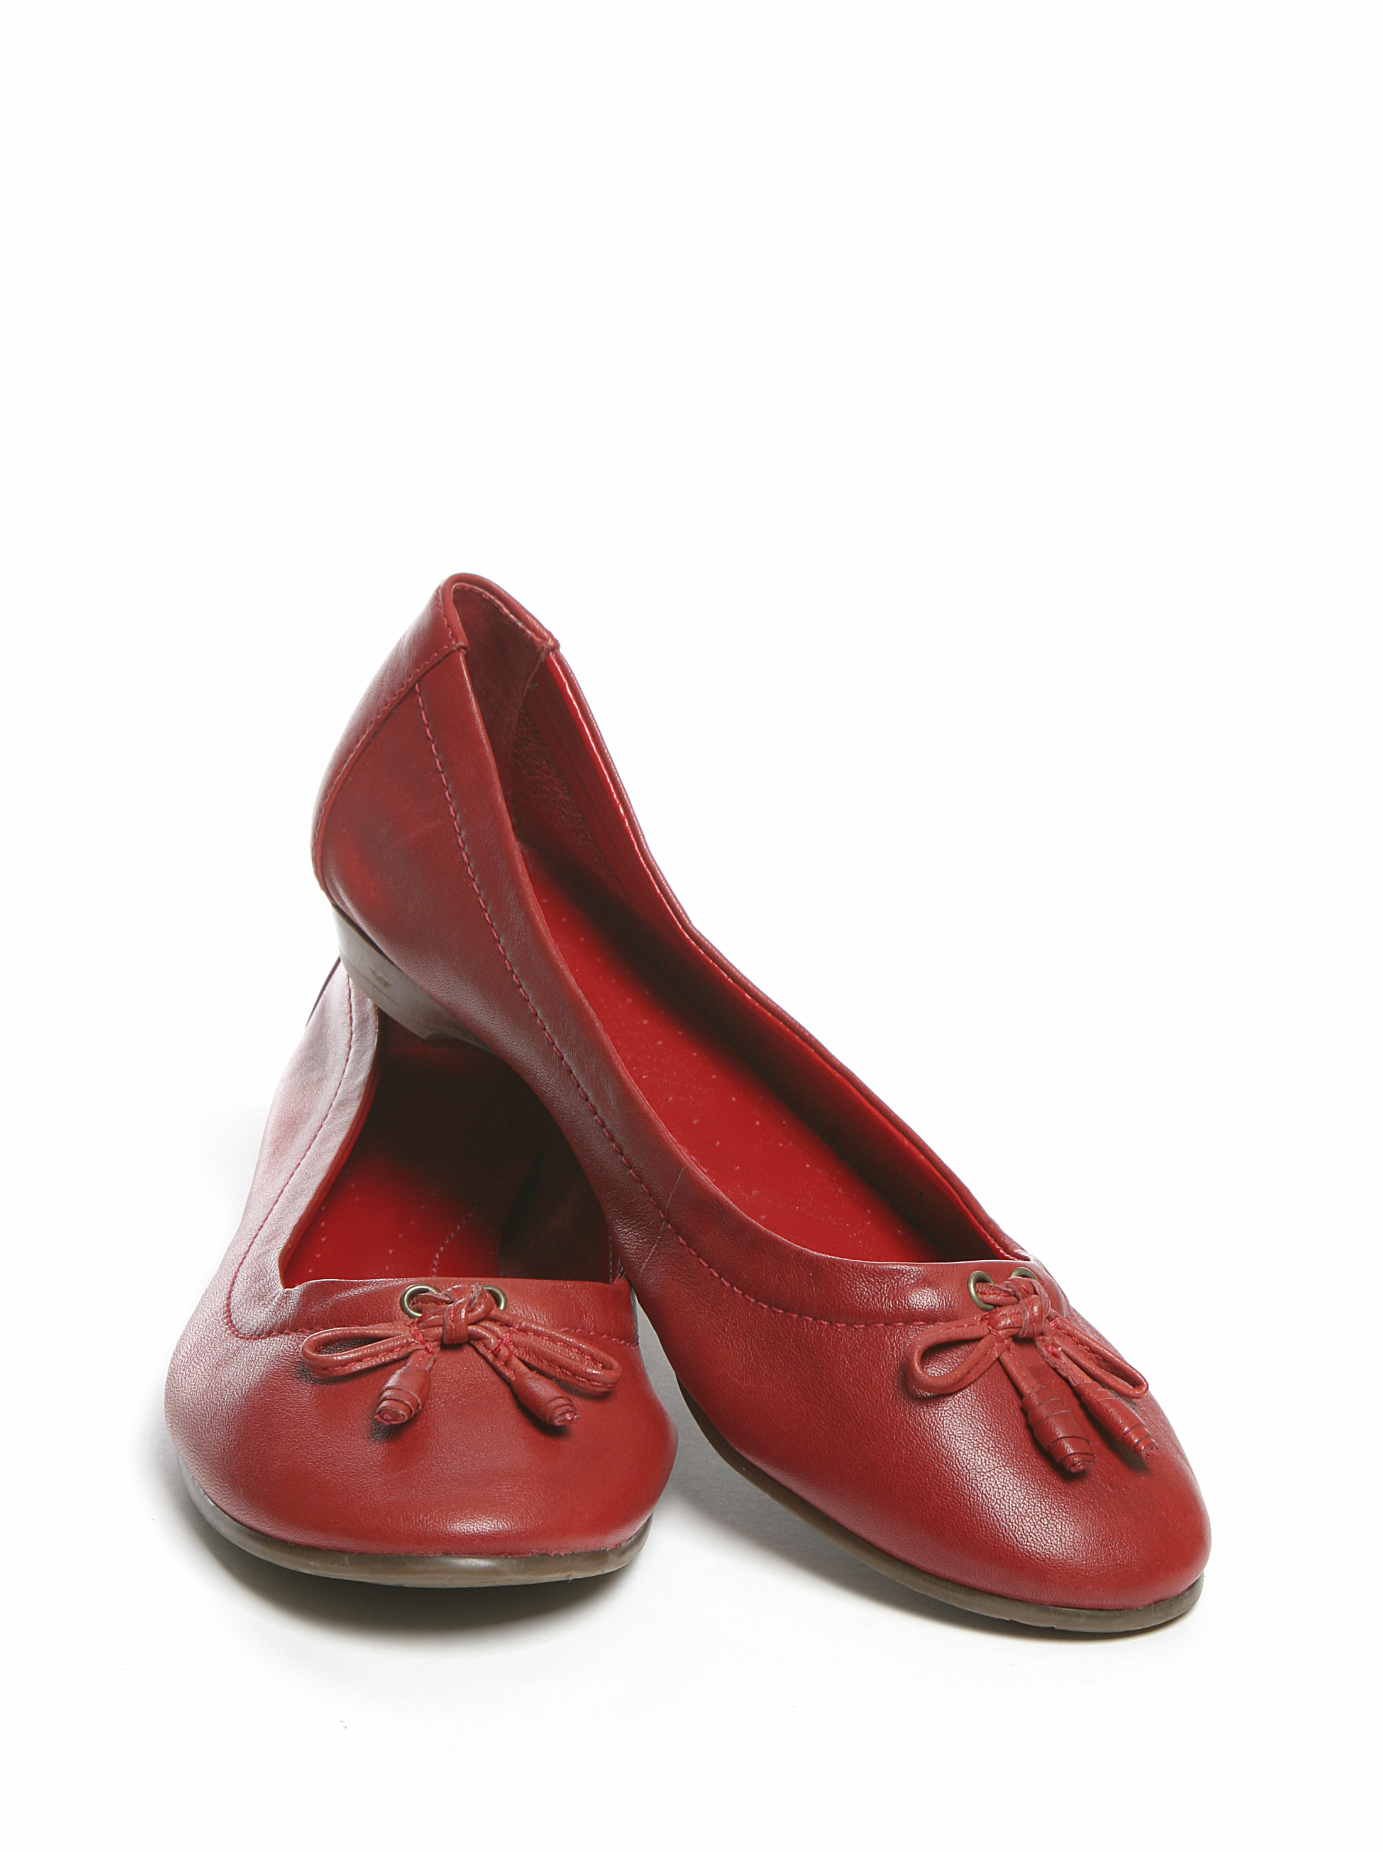
What’s Happening? Why? Where are We Headed?
Insights From Leading Footwear Executives And Innovation Leads
Mass Manufacturing in Asian Factories
New Manufacturing: 3D & Speed Factories
New Product Design & Development
Issues Impacting Manufacturing Innovation

Slide 14

Mass
Manufacturing
Insights

Slide 15
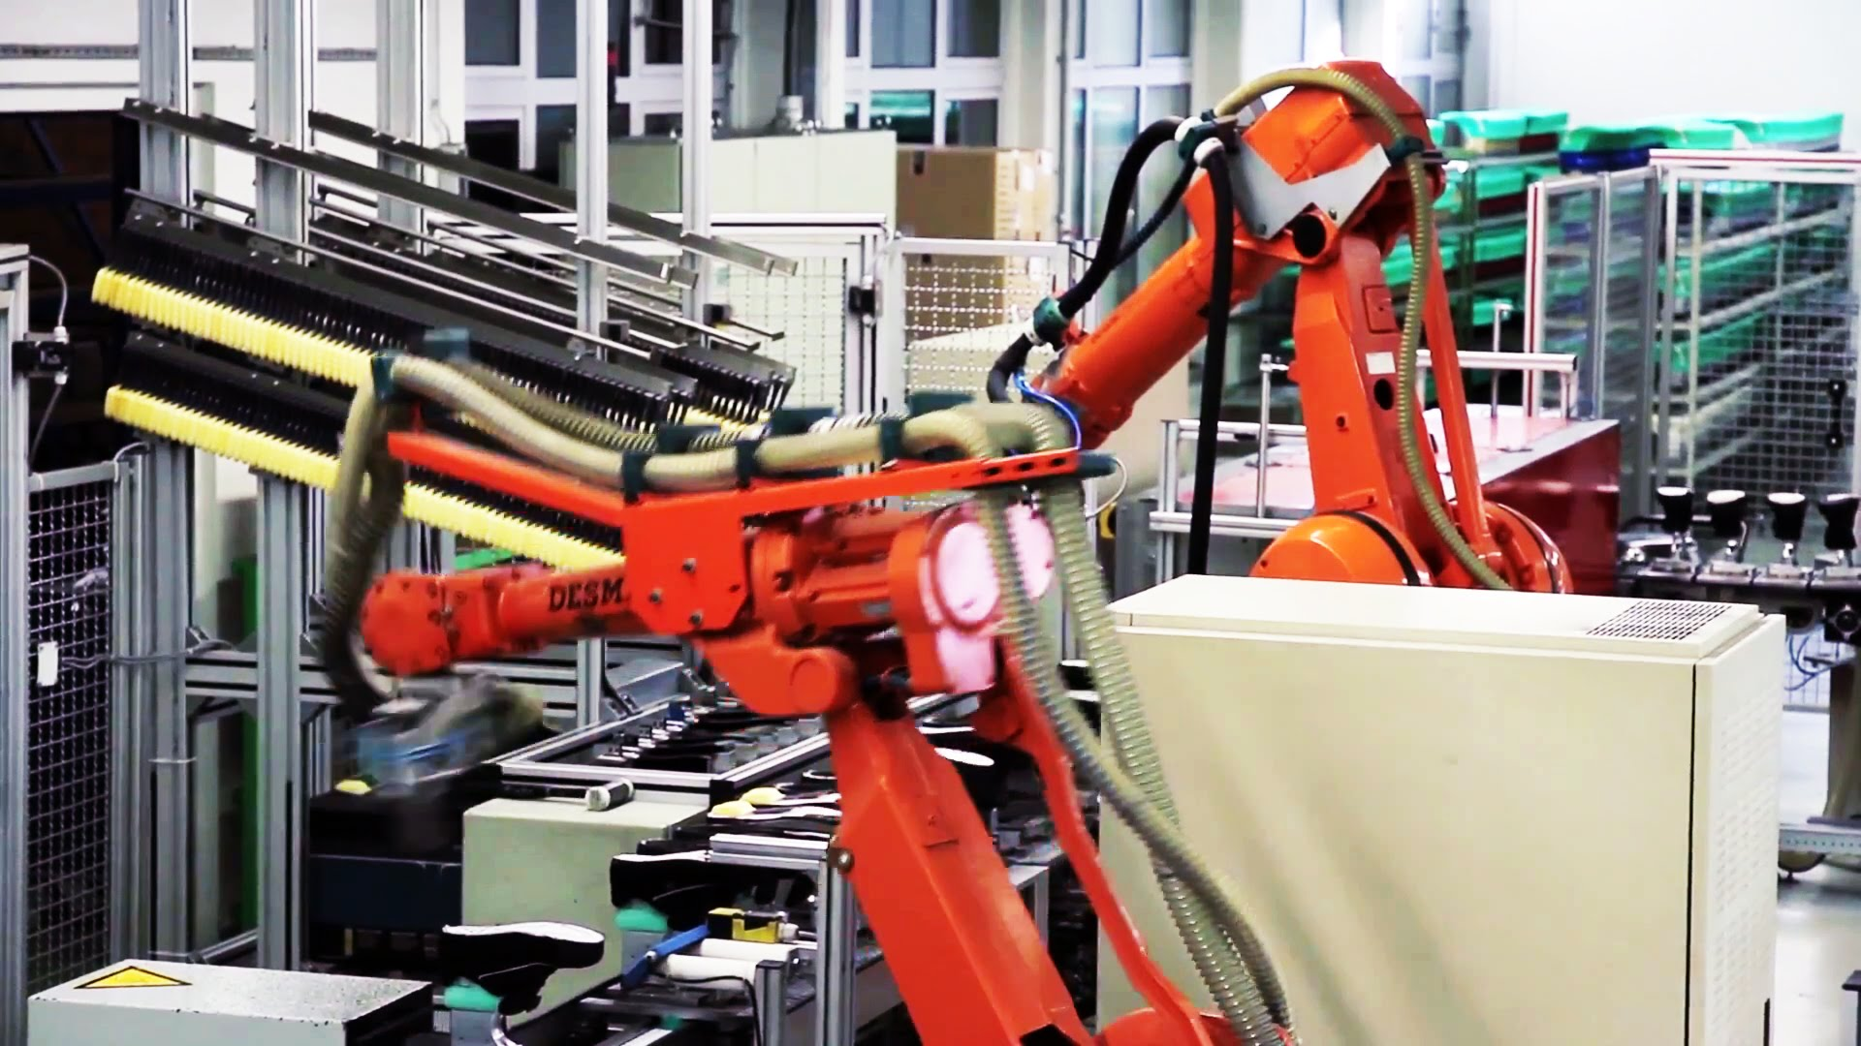
Where We are Headed: Advanced Manufacturing Robotics

Slide 16
Advanced Factory Floors Right Now: Auto Stitching

Slide 17
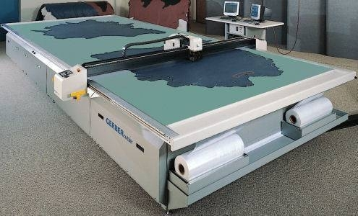
Advanced Factory Floors Right Now: Auto/Laser Cutting

Slide 18
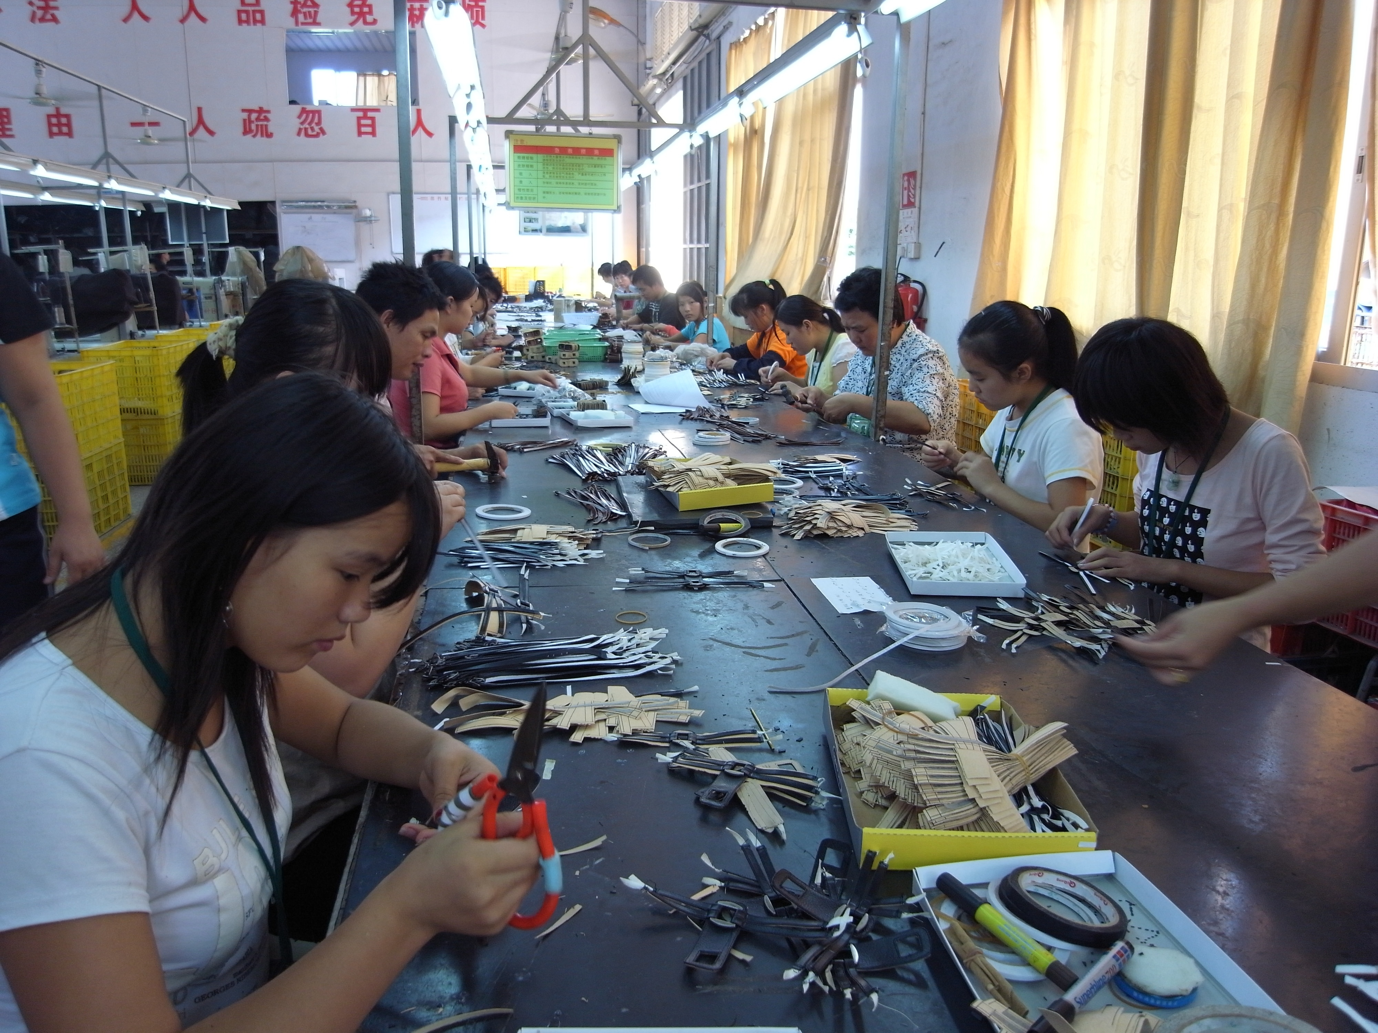
What Most Factories Look Like Today… Even With Advancements

Slide 19

“Never Underestimate Cheap Labor”
Actual monthly take-home pay (average)
Chinese City | 2016 (in RMB) | EURO
Dongguan | 3,425.23 | 467.27
Putian | 3,455.76 | 471.43
Wenzhou | 3,904.13 | 532.65

Slide 20
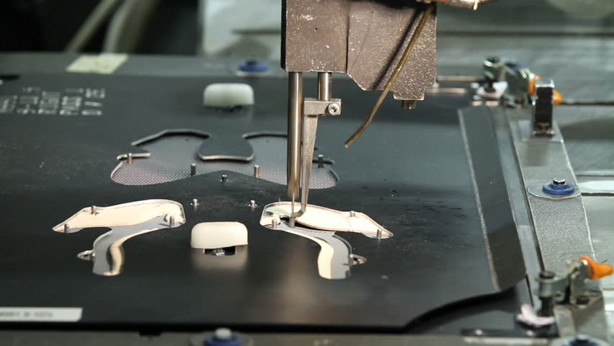
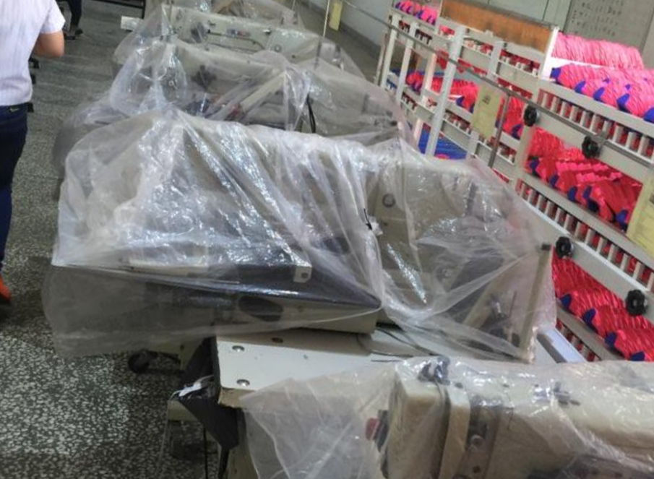
Exec Insights on the Economics of Mass Automation
Efficiency Issues: Machines/robots have one use on a traditional line and have to be reset to function properly for each SKU (size, shape, material, etc). Maintenance. Some machines make sense at the start of assembly but not the middle of end of the line.
Training/Skill issues: Workers may not know
how to use machines properly.
Factory ROI: “why buy a costly machine
when I can add people to the problem area?”
Product ROI: High-end athletic $ v. basic shoes

Slide 21
Exec Insights on the Economics of Mass Automation
Location, Location, Location: Certain manufacturing areas have wages so low there is no need to automate. They can just hire more workers to address assembly bottlenecks. Others see wages rising and need to automate.
Brands: Many factories automating are being helped/pushed to do so by brands.
Ownership/Succession: Chinese owners are looking to automate and may be getting financial support from the state. Taiwanese investors own many of the major factories – the factories automating are the ones whose children are taking over from the owners.

Slide 22
“Shoe factory automation has different layers. True Automation will evolve in the fashion, high price zone. Mass automation is like Henry Ford's assembly line. It was a semi-automated tool that allowed workers to be more productive. It needed less people but still needed people. Today's automation advances in mass will come in parts of the assembly line. Labor will remain cost efficient for awhile. This slows down people thirst to invest.”
- Joe Passio, Director, Global Development & Sourcing at Fila

Slide 23
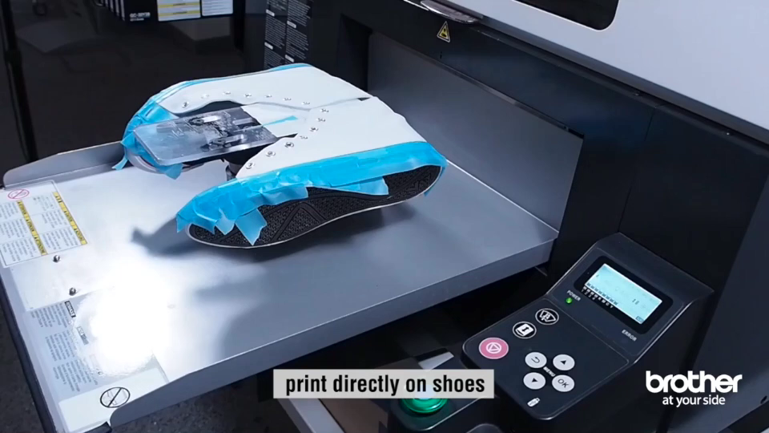
Trending!
Where does the manufacturing process end?
Machines are creating the ability to finish the manufacturing
process in stores - allowing customized images on shoes.

Slide 24
3D & “Speed” Factory
Manufacturing
Insights

Slide 25
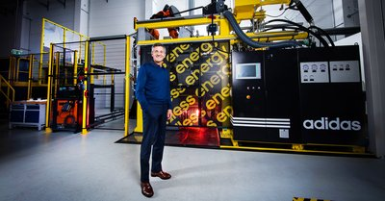
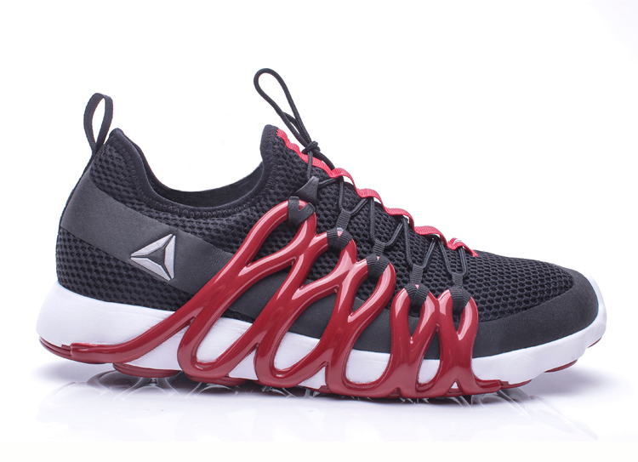
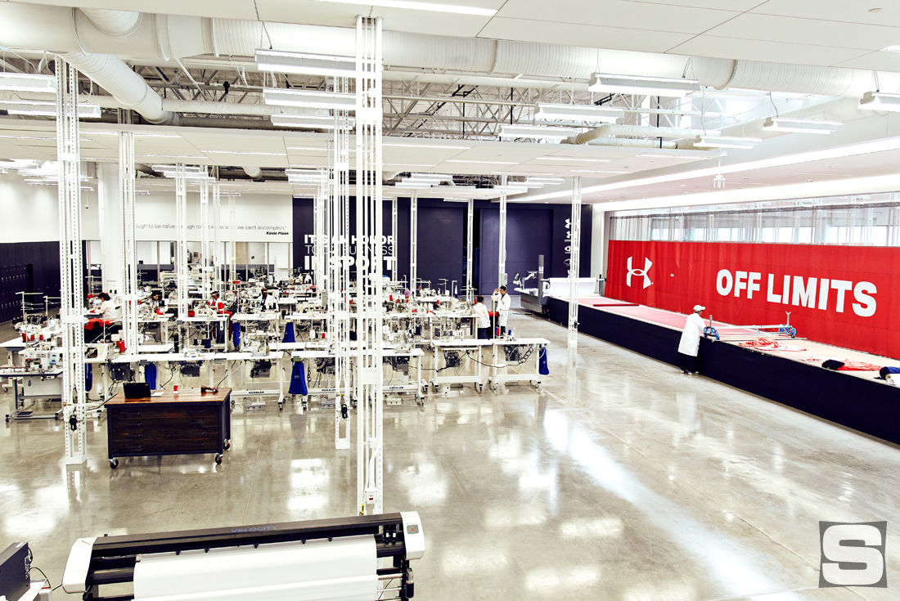
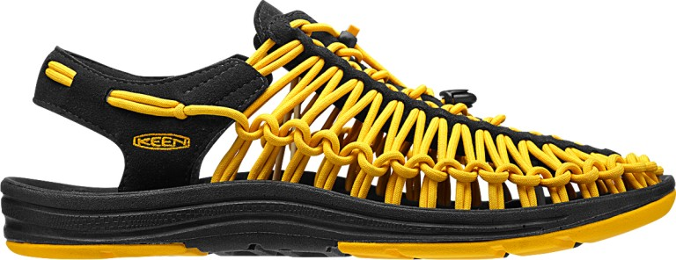
Are these actual factories or R&D labs?

Slide 26
They are Currently R&D Labs Developing into Regional Factories
Notes:
Limited capacity to make runs. Supply chain realignments. High costs to consumers. Good for marketing, harder to commercialze lines. Can do small batch runs in regions – but it has to make economic sense…whats the elasticity of demand and price at the consumer level and whats the opportunity cost at the factory level?

Slide 27
Economics of these future factories
Yes, it’s the future of customization in the age of Amazon…BUT
Capacity and Supply Chains: high capacity runs are years away based on machines, demand v. cost, workers and supply chains are not yet robust enough to support high capacity.
Capital & Location: Every major footwear company is looking to develop regional factories, but it takes a lot of capital and strategic planning to ensure they are in the right places to deliver on time to consumers – as well as in areas that can attract talent.
Product: Do consumers want customized fashion shoes? Yes and no. So the economics of consumer demand means these facilities can only be focused on certain materials and products to get proper ROI.
Price: How do we develop affordable shoes in these facilities to meet more customers?

Slide 28
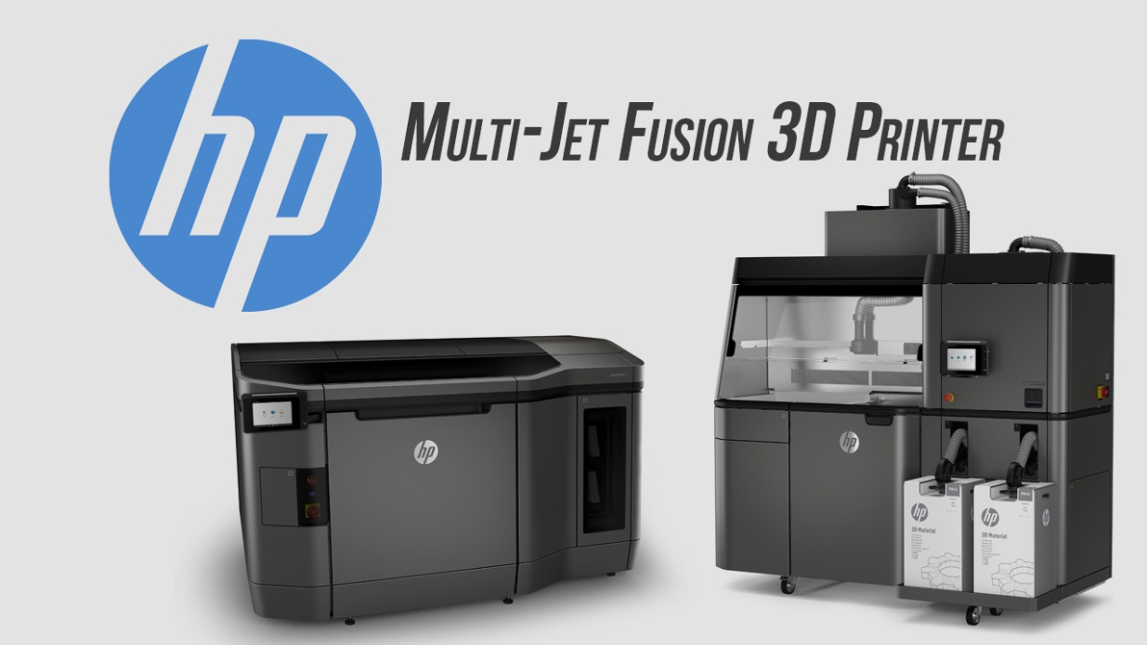
$130k
How do we actually use this technology to commercialize product?
l

Slide 29
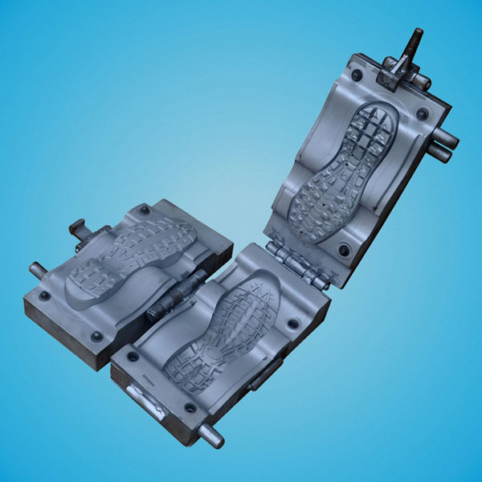
“why 3D print something
that you can injection mold?”

Slide 30
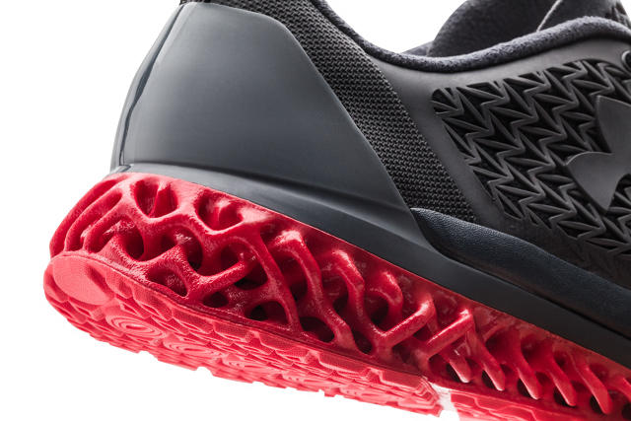
“why 3D print something
that you can injection mold?”
Are 3D Printed Shoes ACTUALLY Better?

Slide 31
It’s cool, but what functionality
problem (size, fit/feel, durability)
are we looking to solve?
Does this solve a current manufacturing challenge? OR are we really just
solving a fashion challenge?

Slide 32
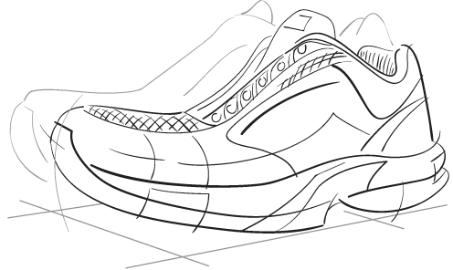
Exec Insights on the Economics of 3D Printing
What new challenges does this create in terms of supply chain, chemical compliance?
What’s a 3D printed shoe cost v. a factory produced shoe? Can we sell these and make money if the cost is over $150? What’s the CBA?
How do we hire the right people who understand shoe commercialization AND the technology? OR how to we re-order our development system to capitalize.
What about mass retail? “No economies [for the typical shoe sold at big box stores]…It is slow, expensive and parts aren’t as good. Anything mass produced is a high mark to hit. Imagine flip flops. You can do it but there is no benefit until you want to make every one slightly different.”
Does the fashion footwear consumer want 3D printed shoes? Do we want to make those?
This is all about materials - metals and plastics are getting better. Anything foamy for uppers or cushioning is a couple years out. For now you “design around” material challenges.

Slide 33
3D Manufacturing: Where are we in 2017
Marketing teams are way ahead of manufacturing teams on 3D
The quality of product is improving…material development is starting to adapt to fit machine capabilities…designers are starting design around components that slow down 3D printing.

Slide 34
3D Manufacturing: Where are we in 2017
Latest and best in class additive manufacturing equipment, like HP Jet
Fusion equipment, is intended for
short-run production of components.
Solve some production bottlenecks
2. and give some ability to customize

Slide 35
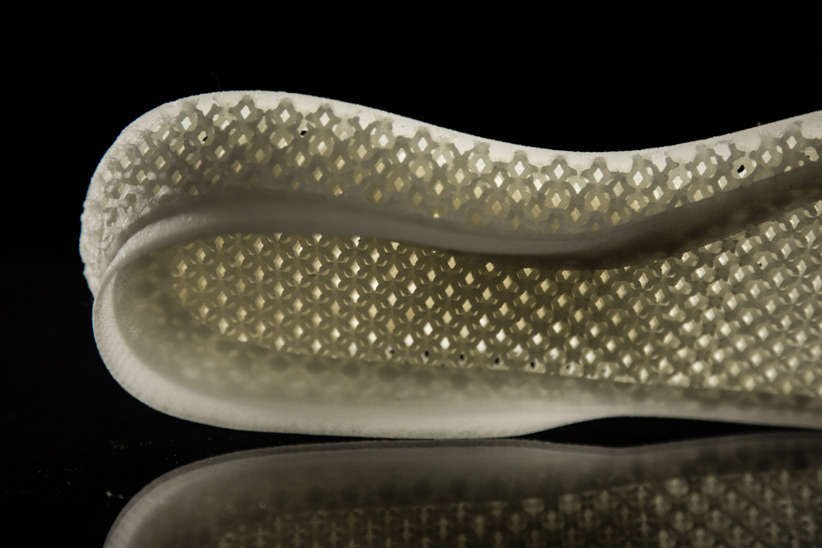
3D Components as part of a shoe – not the whole shoe

Slide 36
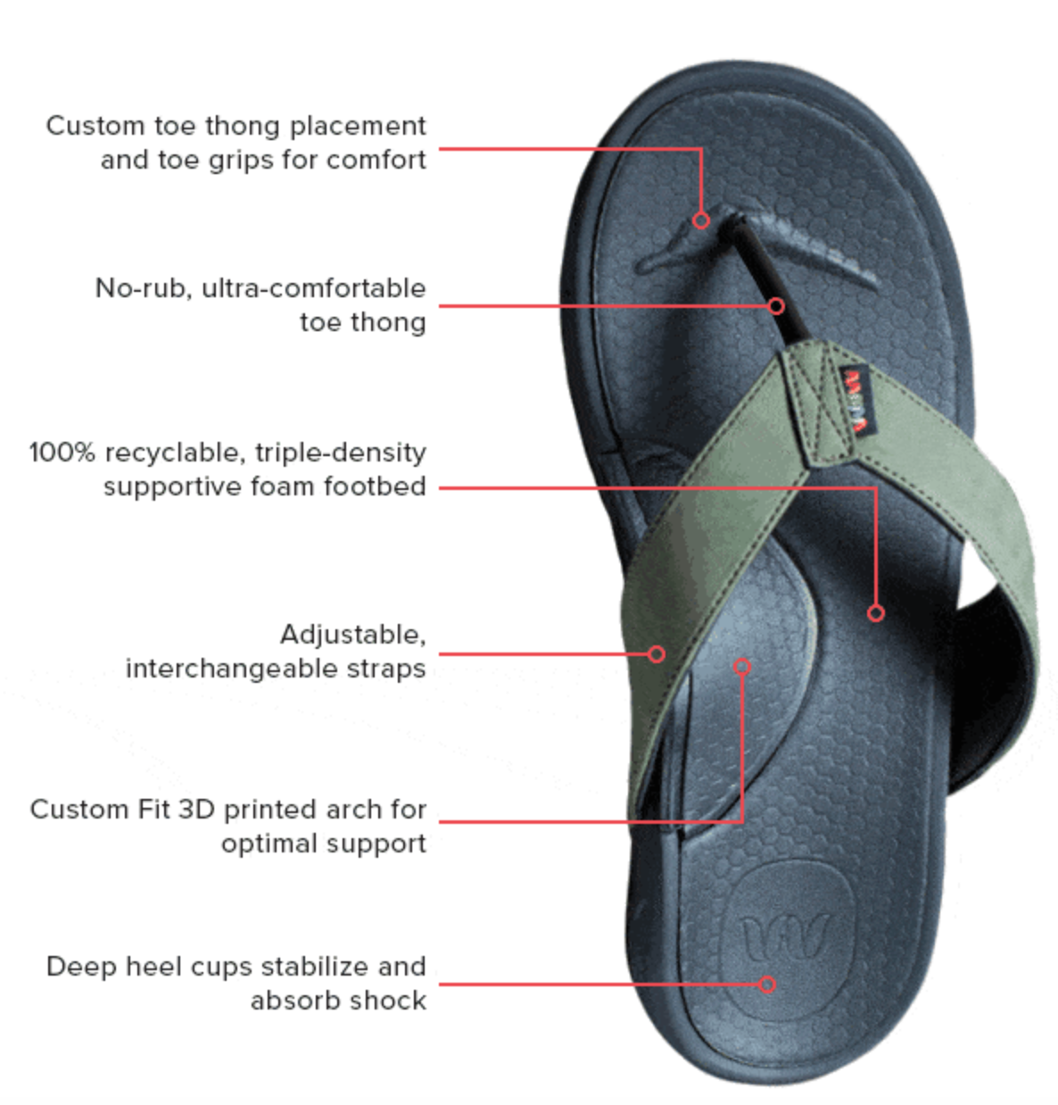

A blend of traditional
components with
A little customization

Slide 37
2020
2025
2030
3D printed materials
and processes matures and spreads industry wide.
May allow medium
capacity production
of whole, decent quality, 3D shoes
($$$).
Algorithms and coding start to mature…
Small 3D labs across the US and EU are making 3D printed custom shoes and they are delivered to your door in 2 days ($$).
BUT! We only see this through current eyes – some major innovation is yet to come to even disrupt 3D printing or 100% improve it.
Printer quality and user competency provides more custom footwear components for more styles &
better fit.
Athletic advance on material innovation & development and start to run higher capacity 3D printed sneakers ($$$$$).

Slide 38
“3D is coming…It is coming in trivial ways, foolish ways as well as compelling ways. It is only the first chapter and the big innovations are yet to come.”
- Chris Hillyer, Innovation Lead, Deckers Brands

Slide 39
Design &
Development
Insights

Slide 40
“It takes just 26 minutes to make a shoe…The rest is
planning & development”

Slide 41
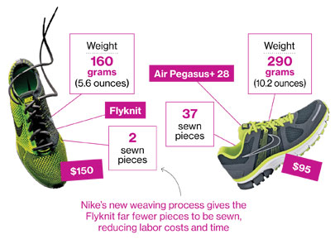
Designing Touches Out of Production

Slide 42
Designing Touches Out of Production
3D shoes that can be mass produced because they
Redesigned the eyelets

Slide 43
Footwear Companies Continue to Move to
TOTAL DEVELOPMENT
Developing a multiuser PLM system & process where GLOBAL
designers
materials teams
commercialization and production teams
compliance personnel
customs personnel
and even sales teams
can get line of sight into, and give input on, samples as they
go through the development process.

Slide 44
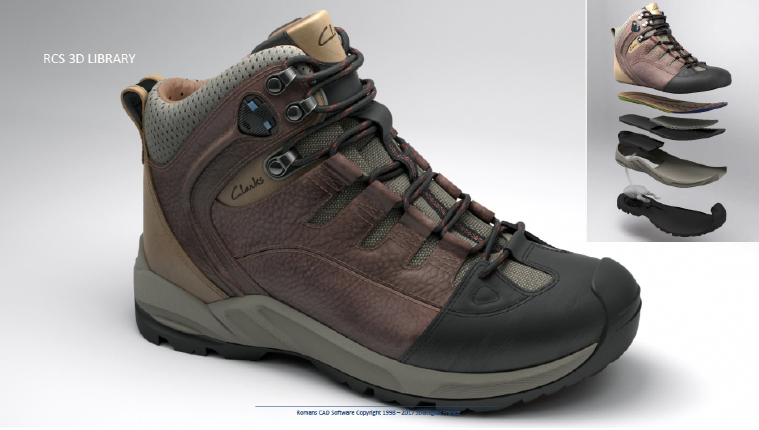
Clarity on:
Materials
Components
Design
Exec Insights on the Economics of 3D Design & Sample Printing

Slide 45
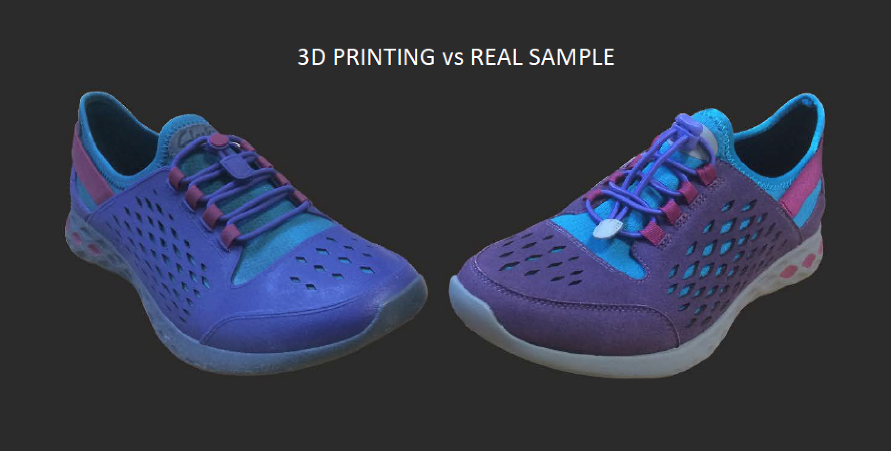
Exec Insights on the Economics of 3D Design & Sample Printing
2-4 days to develop
$300
12-24 weeks to develop
$2,000+

Slide 46
Exec Insights on the Economics of 3D Design & Sample Printing
Time-to-Market: 3D design & printing allows ideas to develop faster! 3D print a concept the same or next day it was designed shrinks brands process from months/weeks to days/hours, helping brands stay competitive.
Mitigate Risk: Being able to verify a design before investing in an expensive molding tool is worth its weight in 3D printed material, and then some. It is far cheaper to 3D print a test prototype then to redesign or alter an existing mold. Being able to show a design to sales teams for input means developing shoes that sell. Compliance and customs teams can also provide input BEFORE production.
Fail Fast & Cheap: Test ideas quickly and discover what doesn’t work to accelerate solution discovery. 3D printing allows product Designers and Developers to make breakthroughs at relatively inexpensive early stage, leading to better products.
Personalize: Standard mass-production means all parts come out of the same mold. With Additive Manufacture, personalized and customized parts can uniquely fit specific needs, allowing custom fits in the footwear industry and setting products apart in fashion and performance. 3D design means consumers can design their own shoe.

Slide 47
Issues Impacting Manufacturing
Advancements

Slide 48
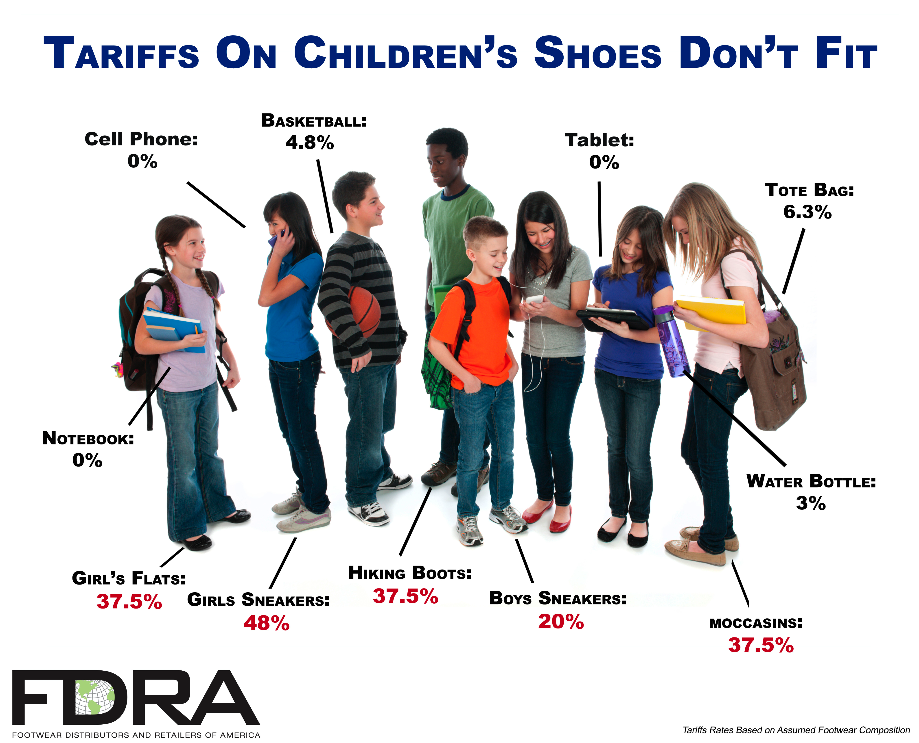
2016
$2.8
Billion Dollar
Duty
Bill

Slide 49
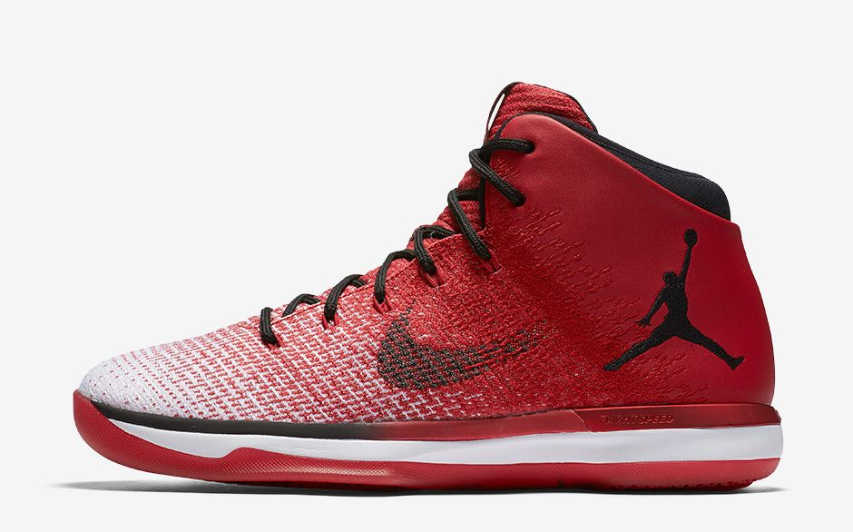

Nationalism = Trade Barriers

Slide 50
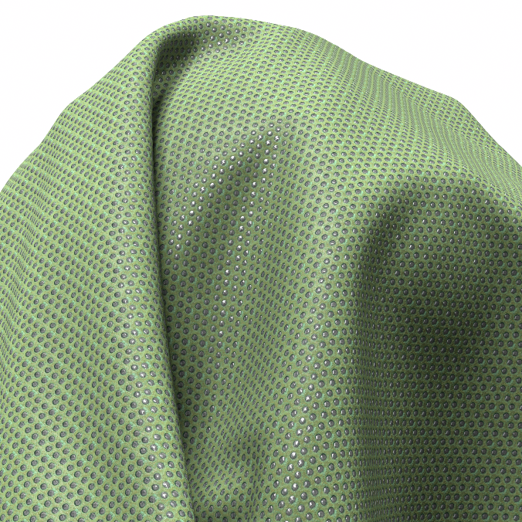
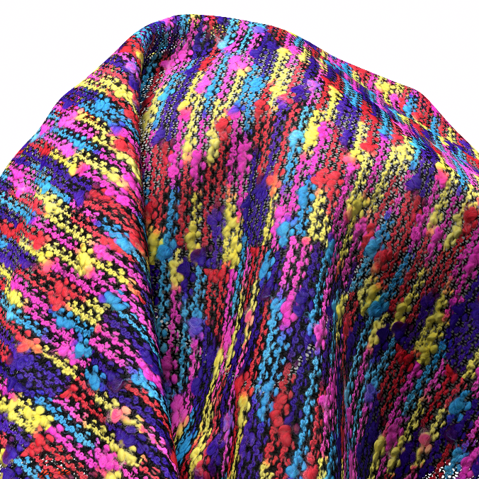
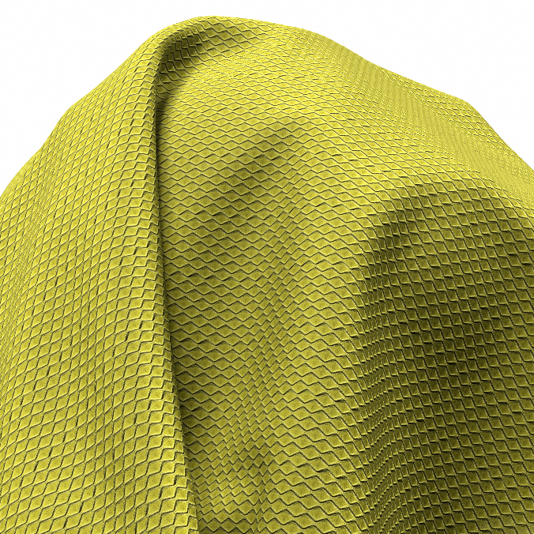
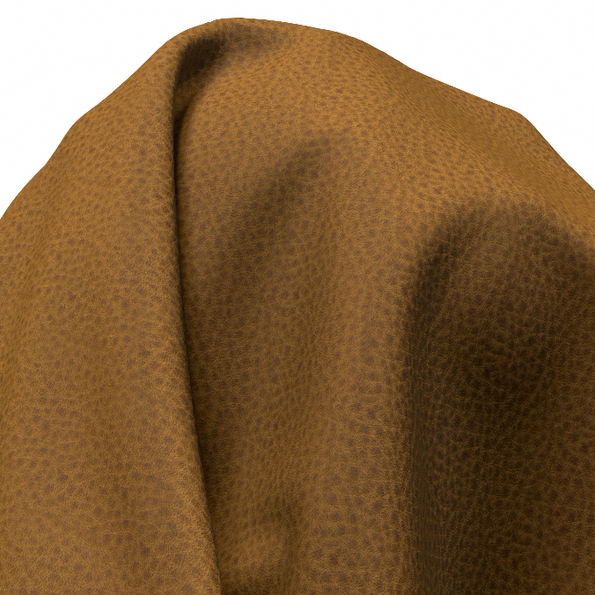
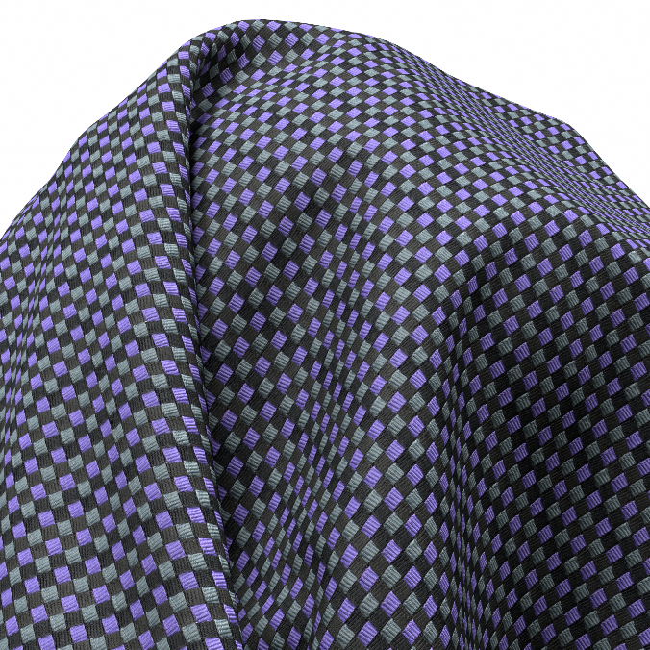
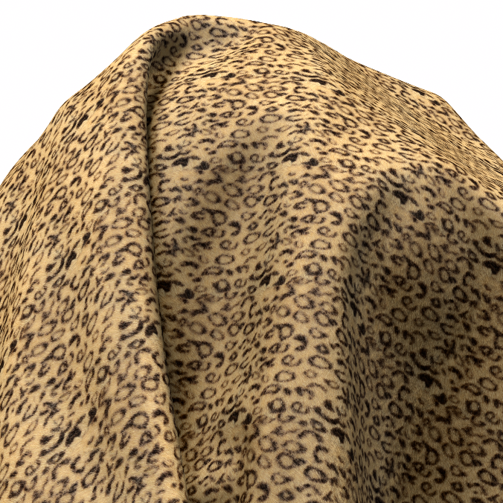
Machines & Materials
Notes:
SMART SCAN

Slide 51
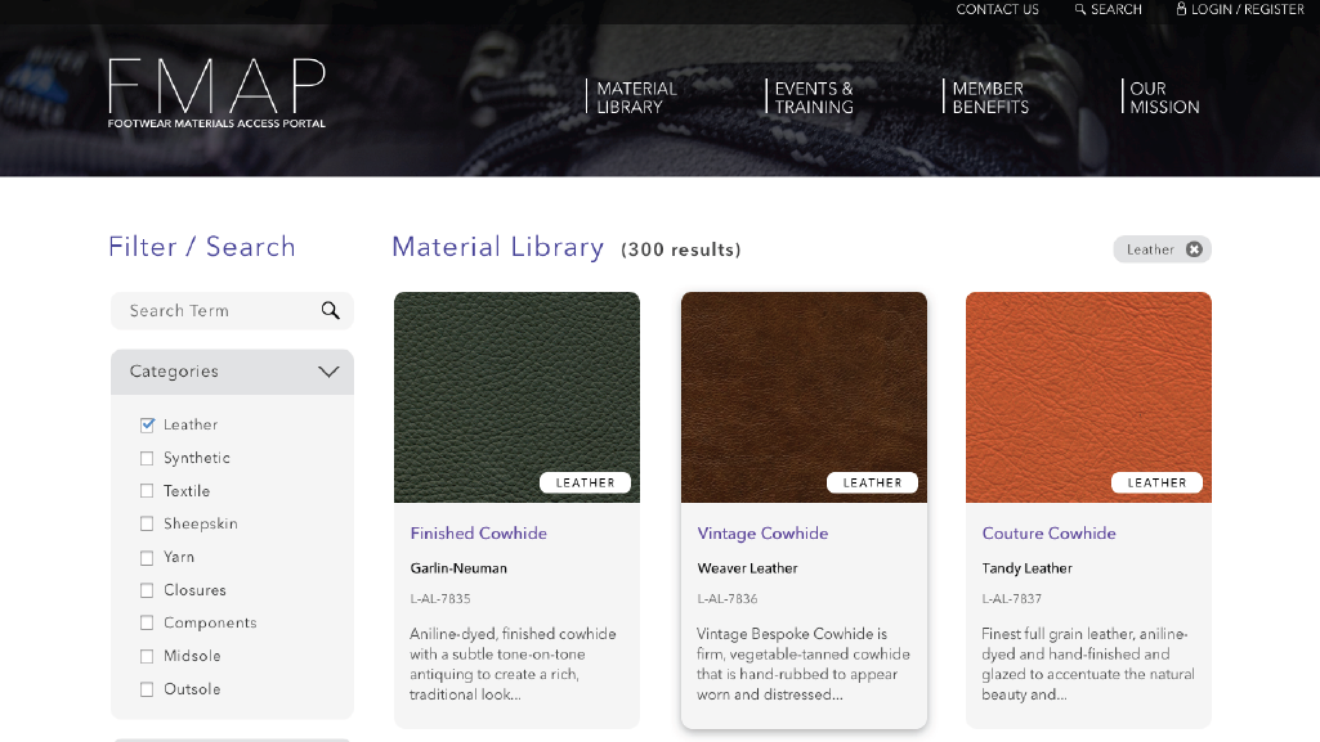

Slide 52

Andy Polk
apolk@fdra.org

